Slide 1
Introduction to Docker and Kubernetes
Jason Umiker, Solutions Architect
24/11/18

Slide 2
What is Docker?
It’s like a lighter weight Virtual Machine (VM)
Based on the Linux kernel features cgroups and namespaces that allow for isolation of processes
So on Windows and Mac it runs on a Linux VM*
Plus some copy-on-write layered union filesystem magic
Plus a declarative build and deployment mechanism
*Unless it is a Windows Container which is now a thing too…

Slide 3




Docker Vocabulary
Image
The basis of a Docker container. Represents a full application
Container
The standard unit in which the application service resides and executes
Engine
Creates, ships and runs Docker containers deployable on a physical or virtual, host locally, in a datacenter or cloud provider
Registry
Cloud or server based storage and distribution service for your images
3

Slide 4
Benefits
Speed – No OS to boot means containers start in seconds
Portability – Image contains all application dependencies and can be easily moved around between infrastructure
Efficiency – Less overhead and improved density
Repeatability – Declarative builds and container orchestration makes changes both safer and easier to automate

Slide 5
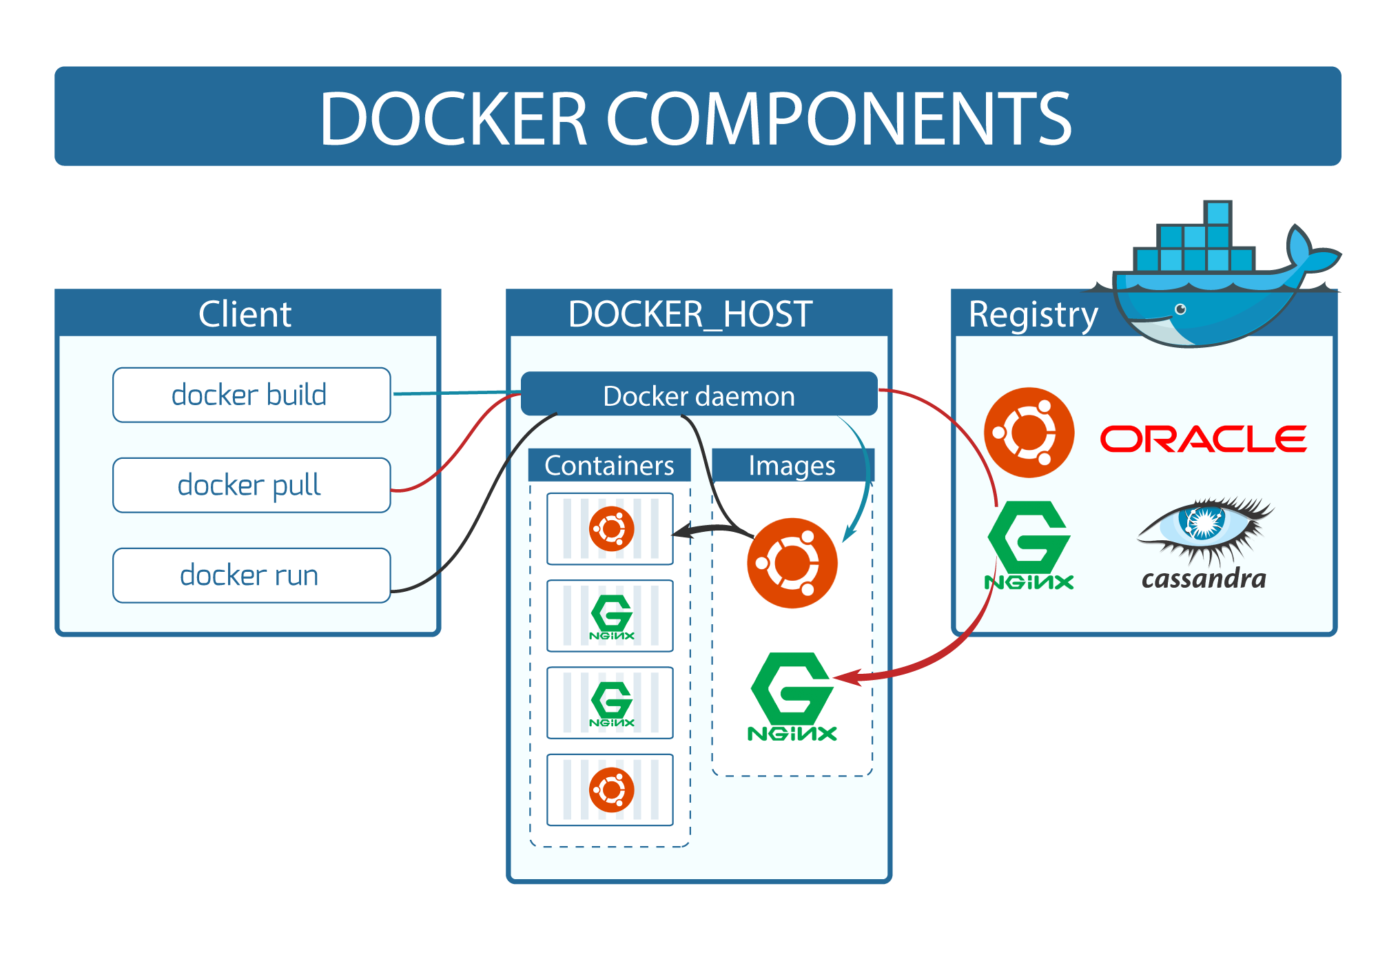

Notes:
From https://robin.io/blog/containers-deep-dive-lxc-vs-docker-comparison/

Slide 6
Docker Image
Read-only template
Used to launch container
Union file systems to combine
different layers into a single image
Docker images built from base
image, instructions to add layers on top
Instructions stored in Dockerfile
Writable
add NGINX
Container
add nodejs
Image
References
parent
image
Ubuntu
Image
Base image
bootfs
kernel

Slide 7
Image Chaining / Using Base Image(s)
tomcat:latest - FROM openjdk:7-jre
openjdk:7-jre - FROM buildpack-deps:jessie-curl
The tomcat people don’t need to worry about maintaining the JDK layers – just getting tomcat working on top of them. And the JDK people don’t need to worry about maintaining Debian base layers.
Notes:
https://hub.docker.com/_/nginx/
https://hub.docker.com/_/openjdk/

Slide 8
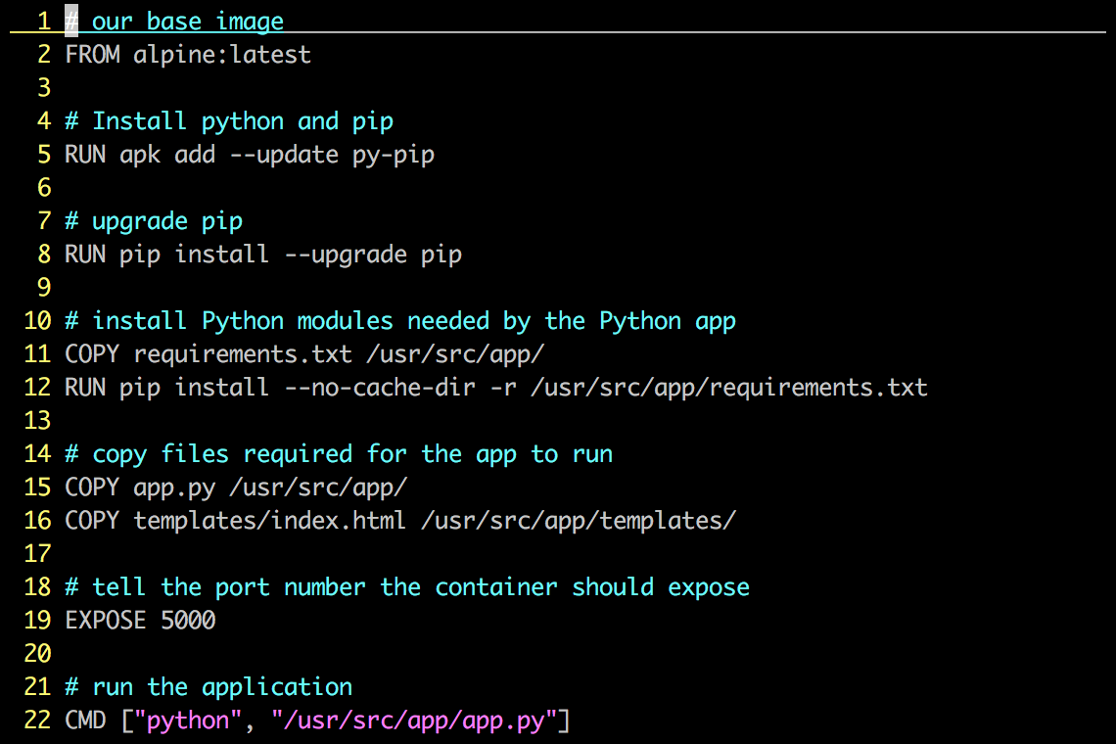
Linux Dockerfile
Instructions on how to build a Docker image
Looks very similar to “native” commands
Important to optimize your Dockerfile
Notes:
A Dockerfile describes how to build a docker image (using the ‘docker build’ command). The commands in the file are a mix of commands you’d actually run to install an application locally (in this case we’re building a python app, and if you’re familiar with Python, you’ll instantly recognize much of what is up on the screen) and specific keywords that tell Docker what to do (RUN a command COPY a file, etc).
An important point about Dockefiles is that they can live with your source code, and be versioned by your version control system. This means Docker images are 100% reproducible. This is another area where VMs and Containers can be different – many times VMs are hand built, and if you lose your golden image you’re out of luck.
This Dockerfile builds a simple flask-based python webapp.
Let’s step through the Dockerfile line by line – note that when the Docker file is processed, all these commands are being run on the Docker image – not your local machine.
Line 1: Build this new Docker image based on the official Apline Linux base image
Line 5: Install Pythong and Pip (the python package manager)
Line 7: use Pip to ensure that Pip is the latest version
Line 11: Requirements.txt holds a list of libraries the app will need, and is used by pip to actually install the library. This line copies the file from your local machine into your Docker image
Line 12: Uses that file and Pip to install the requirements into the container
Line 15: Copy my application code (app.py) into the /usr/src/app directory of the image
Line 16: Copy our index.html file into the /usr/src/app/templates directory of the image
Line 19: The application communicates on port 5000, so we tell Docker to listen on that Port
Line 22: When the container starts up – we fire up Python and pass it out application code to start the app
Again, these steps are pretty much EXACTLY what you would do on a traditional machine to run this application, only here there are being used to create an Docker image.

Slide 9
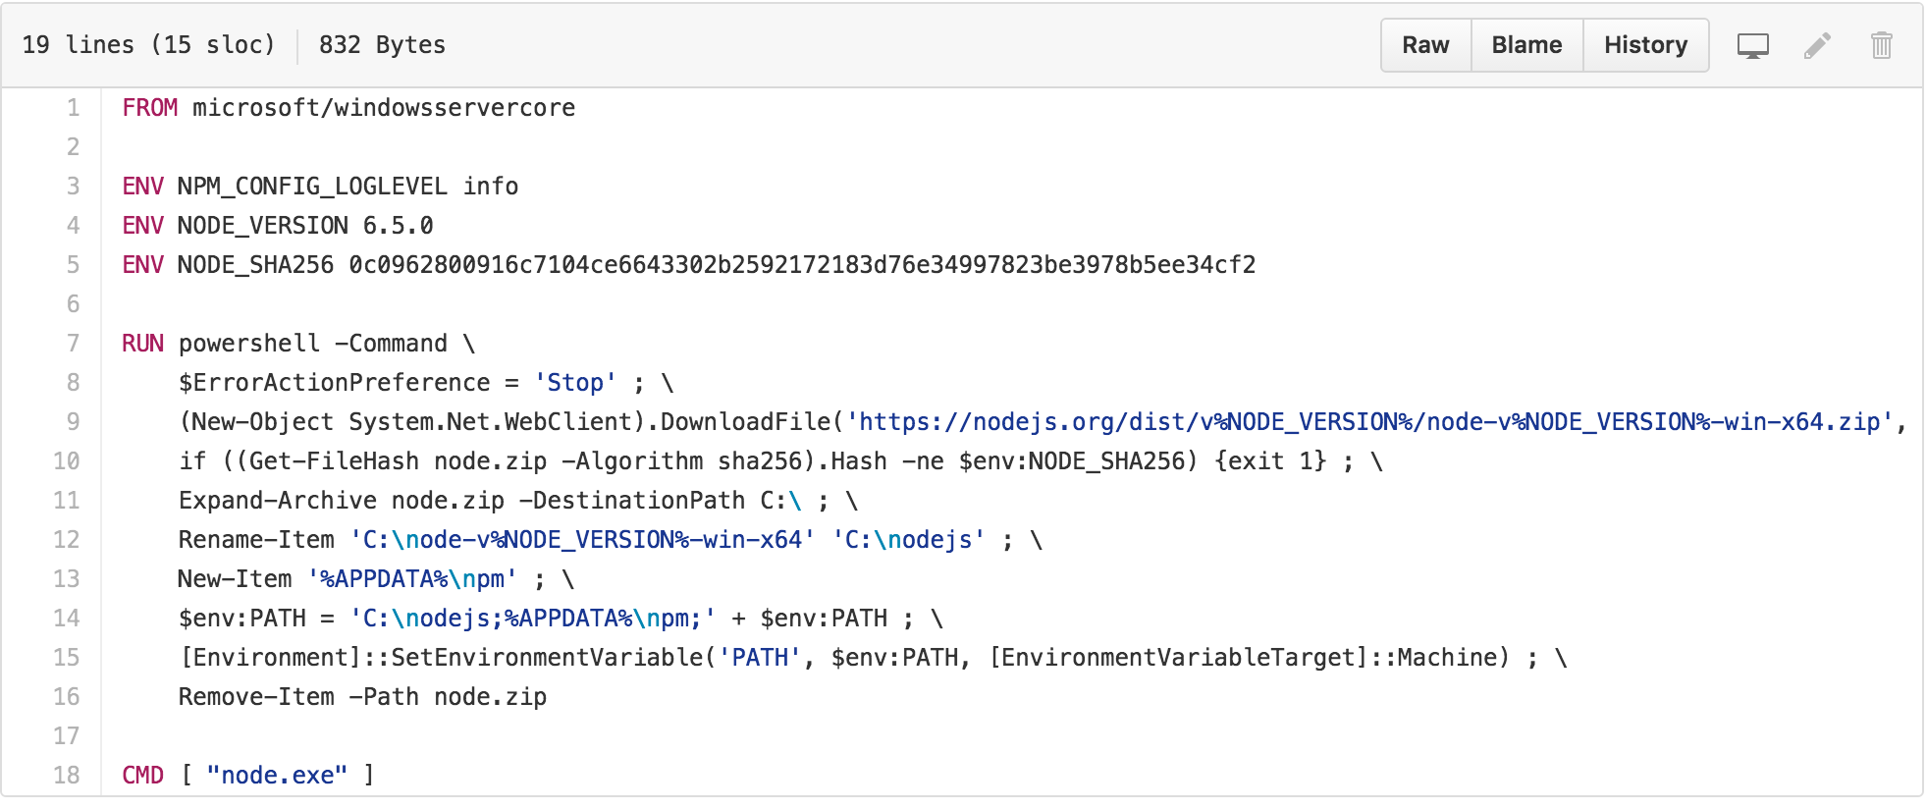
Windows Dockerfile

Slide 10
Dockerfile Reference
FROM <image>:<tag> Sets the base image. Must be first instruction in Dockerfile.
RUN <command> Executes any commands in a new layer on top of the current image and commit the results.
CMD [“exec”, “param1”, “param2”] Sets the command to be executed when running the image.
ENTRYPOINT [“exec”, “param1”, “param2”] Configures a container that will run as an executable.

Slide 11
Dockerfile Reference
EXPOSE <port> Informs Docker that the container listens on the specified network ports at runtime.
ENV <key> <value> Sets the environment variable <key> to the value <value>.
ADD <src> <dest> Copies new files, directories or remote file URLs from <src> and adds them to the filesystem of the container at the path <dest>. *
COPY <src> <dest> Copies new files or directories from <src> and adds them to the filesystem of the container at the path <dest>. *
*ADD or COPY - https://docs.docker.com/engine/articles/dockerfile_best-practices/#add-or-copy

Slide 12
Dockerfile Reference
VOLUME <path> Creates a mount point with the specified name.
USER <user> Sets the user name or UID to use when running the image and for any RUN, CMD and ENTRYPOINT instructions that follow it.
ONBUILD [instruction] Adds to the image a trigger instruction to be executed at a later time, when the image is used as the base for another build.

Slide 13
Basic Docker commands
$ docker pull nginx:latest
$ docker images $ docker run –d –p 8080:80 –-name nginx nginx:latest
$ docker ps
$ docker logs nginx $ docker stop nginx (or <container id>)
$ docker rm nginx (or <container id>)
$ docker rmi nginx:latest (or <image id>)
Notes:
Docker pull pulls an image from the registry to the local host. This example shows us pulling the 1.0 version of the Catweb image from the mikegcoleman repo on Docker Hub
Docker images will list all the images on your docker host
Docker run will start a new container. In this case we are instructing the docker engine to run the mikegcoleman/catweb image we pulled earlier -d tells docker It should start the application in detached mode (running in the backgorund) and –p 5000:5000 tells docker engine that any requests coming into port 5000 on the host should be directed to port 5000 on this container. –name catweb specifies a name for our running container. If you do not specify a name, Docker will generate one (and they can be pretty funny)
Docker ps shows runing containers. ps –a will show all containers, including ones that have been stopped
Docker stop stops a running container (but does not delete it). You can specify the container name (catweb in our example) or the container ID (every image and container are assigned a unique ID)
Docker rm removes the stopped container. if you specify rm –f you will force docker to remove container even if it’s running. again you can specify the name or ID
Docker rmi removes the specified image
Docker build will create a new image from a docker file. In this example we are creating an image called mikegcoleman/catweb and we’re tagging it with a 2.0 version number. The period says to build the image from the docker file in the current directory. You can explicitly specify a path to your dockerfile if you so choose
Docker push is the opposite of Docker – it pushes an image up to a registry. In this case we’re pushing our newly created docker image up on to hub.

Slide 14
Basic Docker commands
$ docker build –t jasonumiker/nginx:1.0 .
$ docker history jasonumiker/nginx:1.0
$ docker push jasonumiker/nginx:1.0
Notes:
Docker pull pulls an image from the registry to the local host. This example shows us pulling the 1.0 version of the Catweb image from the mikegcoleman repo on Docker Hub
Docker images will list all the images on your docker host
Docker run will start a new container. In this case we are instructing the docker engine to run the mikegcoleman/catweb image we pulled earlier -d tells docker It should start the application in detached mode (running in the backgorund) and –p 5000:5000 tells docker engine that any requests coming into port 5000 on the host should be directed to port 5000 on this container. –name catweb specifies a name for our running container. If you do not specify a name, Docker will generate one (and they can be pretty funny)
Docker ps shows runing containers. ps –a will show all containers, including ones that have been stopped
Docker stop stops a running container (but does not delete it). You can specify the container name (catweb in our example) or the container ID (every image and container are assigned a unique ID)
Docker rm removes the stopped container. if you specify rm –f you will force docker to remove container even if it’s running. again you can specify the name or ID
Docker rmi removes the specified image
Docker build will create a new image from a docker file. In this example we are creating an image called mikegcoleman/catweb and we’re tagging it with a 2.0 version number. The period says to build the image from the docker file in the current directory. You can explicitly specify a path to your dockerfile if you so choose
Docker push is the opposite of Docker – it pushes an image up to a registry. In this case we’re pushing our newly created docker image up on to hub.

Slide 15
Intro to Kubernetes

Slide 16
Going from this…
App1
App2
Bins/Libs
Bins/Libs
Guest OS
Server
Notes:
-You realize that while it’s easy to run a couple of containers, running hundreds or thousands of them is difficult

Slide 17
.. to this - is hard!
Guest OS
Guest OS
Guest OS
Guest OS
Guest OS
Guest OS
Guest OS
Guest OS
Guest OS
Guest OS
Guest OS
Guest OS
Server
Server
Server
Server
Server
Server
Server
Server
Server
Server
Server
Server
Guest OS
Guest OS
Guest OS
Guest OS
Guest OS
Guest OS
Guest OS
Guest OS
Guest OS
Guest OS
Guest OS
Guest OS
Server
Server
Server
Server
Server
Server
Server
Server
Server
Server
Server
Server
Guest OS
Guest OS
Guest OS
Guest OS
Guest OS
Guest OS
Guest OS
Guest OS
Guest OS
Guest OS
Guest OS
Guest OS
Server
Server
Server
Server
Server
Server
Server
Server
Server
Server
Server
Server
Guest OS
Guest OS
Guest OS
Guest OS
Guest OS
Guest OS
Guest OS
Guest OS
Guest OS
Guest OS
Guest OS
Guest OS
Server
Server
Server
Server
Server
Server
Server
Server
Server
Server
Server
Server
Guest OS
Guest OS
Guest OS
Guest OS
Guest OS
Guest OS
Guest OS
Guest OS
Guest OS
Guest OS
Guest OS
Guest OS
Server
Server
Server
Server
Server
Server
Server
Server
Server
Server
Server
Server
Notes:
This gets a lot more difficult when you have a lot of machines and a lot of containers.
Generally this implies you’re managing a cluster & cluster management is hard.
You’re probably not writing your own cluster management solution, this isn’t a trivial problem and there are better ways to spend your engineering cycles.
You need a way to intelligently place your containers on the instances that have resources you need and that means you need to know the state of everything in your system. You need a way of tracking and aggregating all the individual resources from all the machines across the cluster and make them available to run your jobs.
Information you might need to track include
Is machine X up and running?
Does machine X have resources available to run a job?
Is the job that machine X is running still running? Did it fail?
We need a tool to handle this for us.

Slide 18
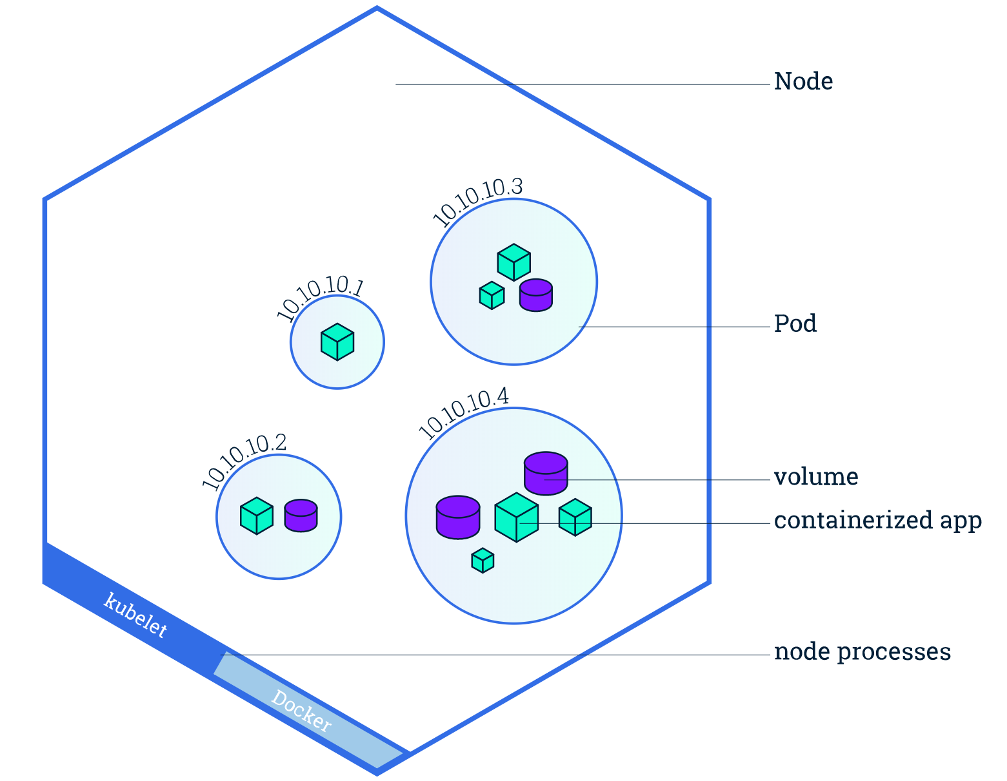
Kubernetes Basic Vocabulary
Node – A physical or virtual machine to run containerised workloads.
Pod – One or more containers run together on a host. They share the IP and any volumes.
Sidecar – Another container that runs alongside each main container/workload within each Pod.

Slide 19
Kubernetes Basic Vocabulary
Volume – Storage that can be shared between containers in a Pod. Can optionally persist with PersistentVolumes.
ReplicaSet – Ensures the specified number of Pods are running and in the right places (across AZs etc.)
Deployment – Manages change of ReplicaSets and (vicariously) the Pods they manage.
StatefulSet – Similar to a Deployment but allows for ordering and uniqueness to help with stateful applications.

Slide 20
Kubernetes Basic Vocabulary
Service – Creates an endpoint to reach all the Pods of a particular app/service. Often via a load balancer.
Label – Key-value pairs that can be attached to any object
Label Selector – Filter objects based on their Labels
Namespace – Logically separated part of the cluster used for access control and workload / team segregation
kubectl – The commandline tool for managing Kubernetes

Slide 21
https://github.com/jasonumiker/docker-kube-intro-workshop https://eksworkshop.com

